Slide 1
BikeToData
Lorenzo Argante, Sinja Buri
Soren Heitmann, Riccardo Rinaldi
Valentina Tortolini

Slide 2





Team
Lorenzo Argante
Soren Heitmann
Riccardo Rinaldi
Sinja Buri
Valentina Tortolini

Slide 3
Data
Environmental
Transport
📢
🌪
🚲
🚎
Geospatial
coordinates
🌎
Key places
Demography
🏥
📚
🛍
👨
👩

Slide 4
Target and Methods
Main Focus: Bike sharing:
Visualization (D3js, GeoJSON, OpenStreetMap):
map of bike stations;
status of the stations (empty/full/broken);
temporal evolution of the stations status.
Data analysis (Spark, Pandas,…):
Correlation with key places/environmental variables/other information;
probability of empty/full stations;
attractiveness of stations;
management policies and public expenditure.
Secondary focus:
Spatial correlation of data with recent ballots results → external data

Slide 5
Timeline
Week four → investigation and early visualisation of data
Week five → data analysis and visualisation of the results

Slide 6
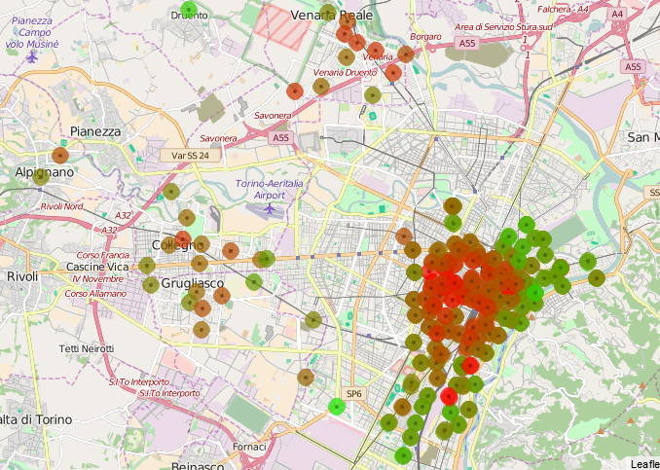
Exploratory Results
Red: Bike locations that are, on average, low/no availability
Green: Bike locations that are, on average, high availability
Clear demand around center areas
Suburban centers show good demand

